Slide 1

Medical Image Diagnostics
12/5/2024
Group 24
Tanuj Dave
Snigdha Ghosh
Aryan Chauhan

Slide 2

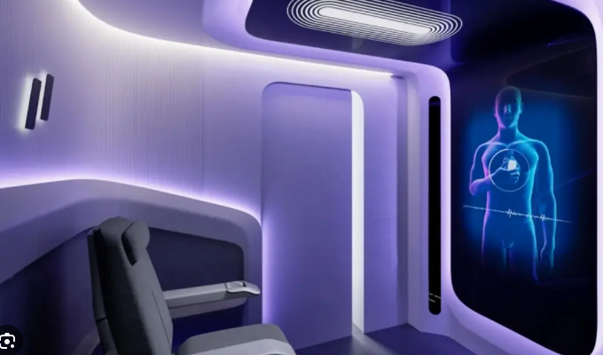
About
Why
Rapid advancements in healthcare technology and availability of medical imaging data
Helps doctors:
Prioritize patients
Highlight points of interest
Help patients:
Better understand diagnosis
Medical Diagnostics Pods
What
Leverage computer vision techniques to
Image analysis
Highlight key points
Diagnostics
Measure performance
Compare
Latent Feature extraction
Accuracy, Scaling…
Notes:
Huge advancements in AI and Adoption Across industries
We want to use Computer Vision to help doctors prioritize patients, highlight points of interest
Help patients understand their diagnostics
There are AI Medical Pods that scan and perform tests and draw out comprehensive diagnostic reports
We leverage Computer Vision techniques
To perform image analysis and diagnostics
Measure and Compare them to see where they can be used

Slide 3
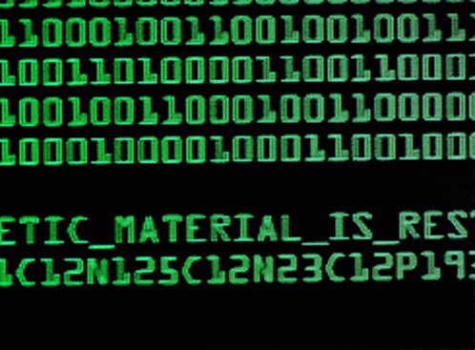
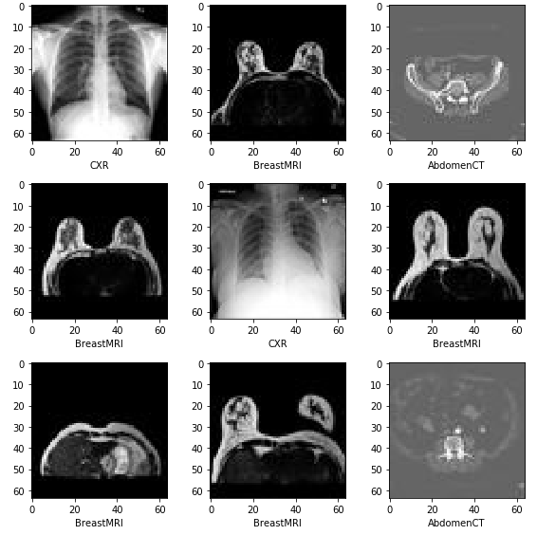
Data
Medical MNIST
60000 medical images
MNIST style — 64 X 64
6 classes
Simple dataset
Benchmark simple and complex models

Slide 4
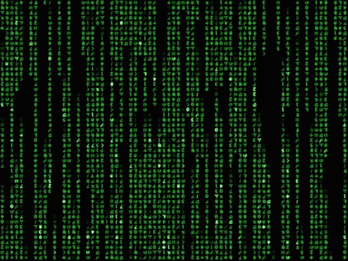
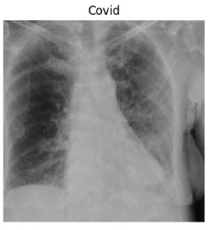
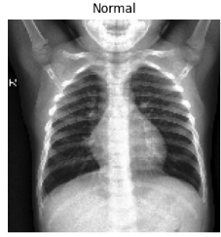
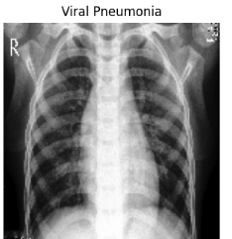
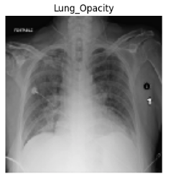
Data
COVID 19 Radiography
40,000 images
128 X 128
4 classes
Complex
Benchmark advanced, larger models
Stress test smaller models
Notes:
Complex data set as we need to extract detailed features from the lung scans because covid and viral pneumonia scans look almost similar

Slide 5
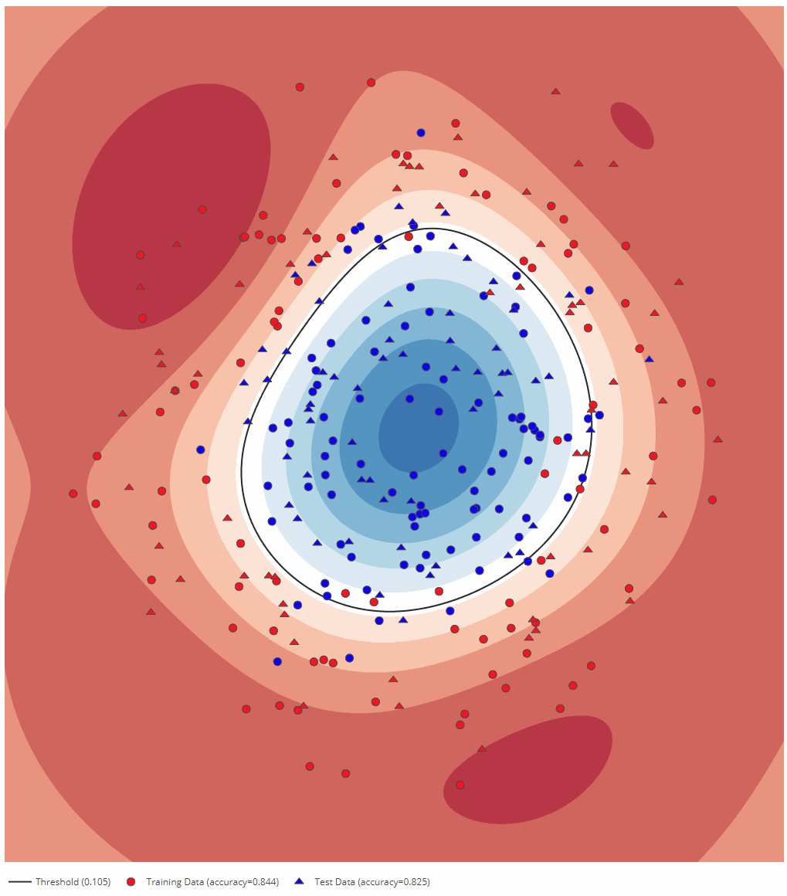
Approach 1 (Margin Master)
Simple Old fashioned models
SVM
k Means
How to extract latent features?
HoG
SIFT
Data Preprocessing
3 channels => 1 channel
Notes:
Simple hyperplanes to separate latent features
Latent features – HoG, SIFT

Slide 6
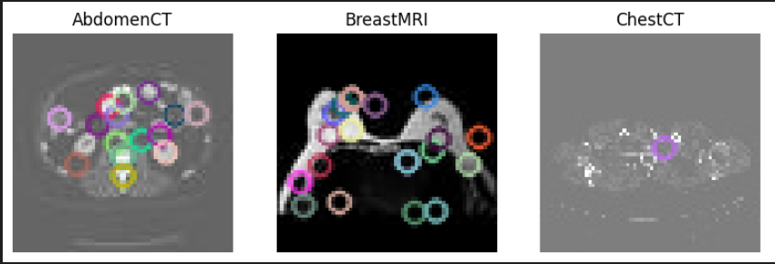
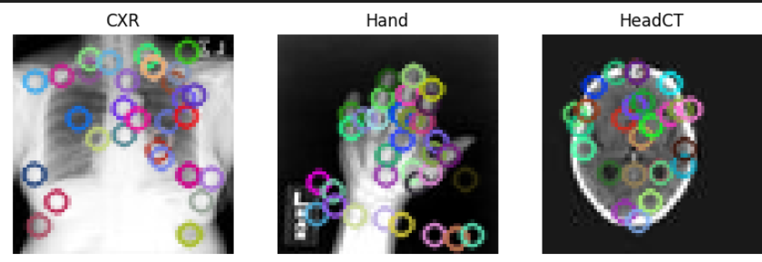
Approach 1 (Margin Master)
HoG Extraction
8 x 8 pixel cells
2 x 2 cells per block
Normalize
SIFT
Use Masks
Similar to HoG
Max 100
SVM
Which one is better?
Why?
Dataset Test Accuracy | HoG | SIFT
MNIST | 99.5% | 88.75%
COVID19 | 88.2% | 76% (w/ Mask)
Notes:
Trained using SVM after feature extraction
HoG is better even with masking for SIFT (cannot extract complex features that well)

Slide 7
Approach 1 (Margin Master)
How can we make it better?
SIFT + BoW + SVM
Feature extraction
Train K-Means
Histogram of Distances (words)
SVM
What's Happening?
Is there something else to try?
Dataset Test Accuracy | 1000 Images | 5000 Images
MNIST | 21.2% | 34.4%
COVID19 | 16.5% | 58.75%
Dataset Test Accuracy | 50 words | 100 words | 500 words
MNIST | 20.25% | 21.2% | 15.2%
COVID19 | 46.25% | 58.75% | 22%
Notes:
Supercharge it?
Sift extraction (1:40)
k-Means to form Clusters of Features OR Words
Histogram of Distances From those Words
Train SVM on it
Much worse even with bigger dataset
More words also gives worse results

Slide 8
Approach 1 (Margin Master)
DTrees
Ensemble Methods
Boosting
Bagging
Using
Decision Trees
SVM
Additional Methods Tried
Ensemble + Mask
Convolution?
Dataset Test Accuracy | Bagging + SIFT | Gradient Boosting + SIFT
MNIST | 89.5% | 90.0%
COVID19 | 48.2% | 55.3%
SVM
Dataset Test Accuracy | Baggin + SIFT | Ada Boost + SIFT | Bagging + HoG | Ada Boost + HoG
MNIST | 86.5% | 76.7% | 99.5% | 86.25%
COVID19 | 51% | 45.2% | 77.5% | 82.5%
Notes:
Lets try ensemble techniques
Boosting Bagging
Use DTrees and SVM as estimators
SVM is better than DTrees
Boosting performing worse than bagging
HoG is always better than SIFT
Not able to extract features and use them to draw overall patterns for complex features
Is there a better way to extract features and further form features using them? – thats where convolution comes in

Slide 9
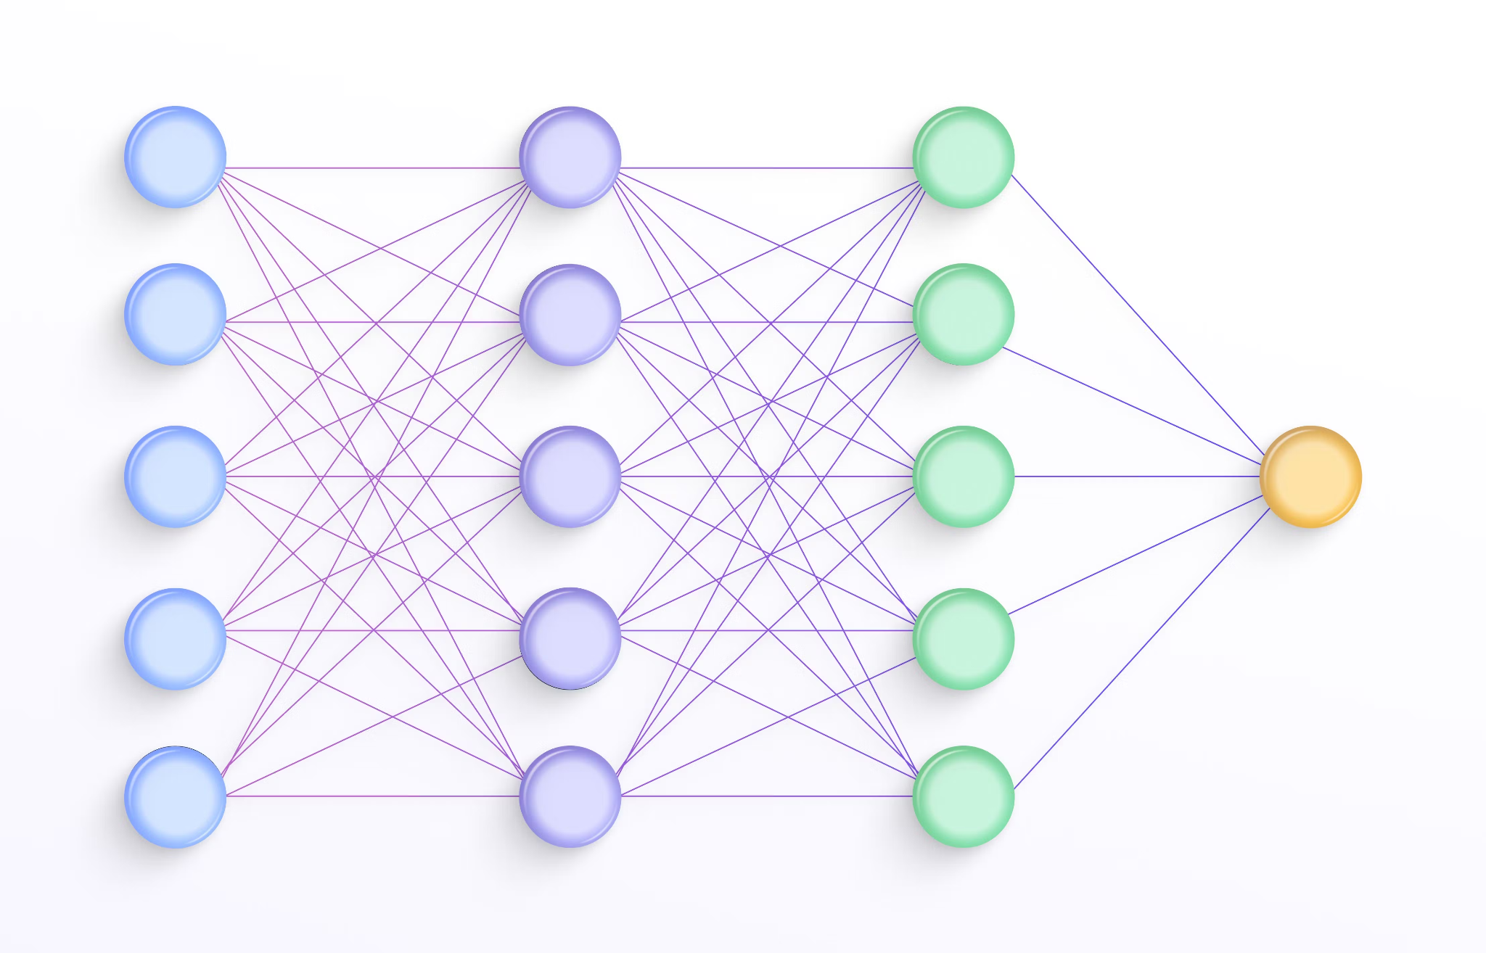
Approach 2 (Layer Slayer)
Data Preprocessing
Resized images to 128x128.
Normalized pixels to [0,1].
Data Augmentation
Handling class imbalances
Custom CNN consisting of a Base and Advanced model
Different optimizers
Notes:
deep learning algorithms designed for image recognition and classification tasks.

Slide 10
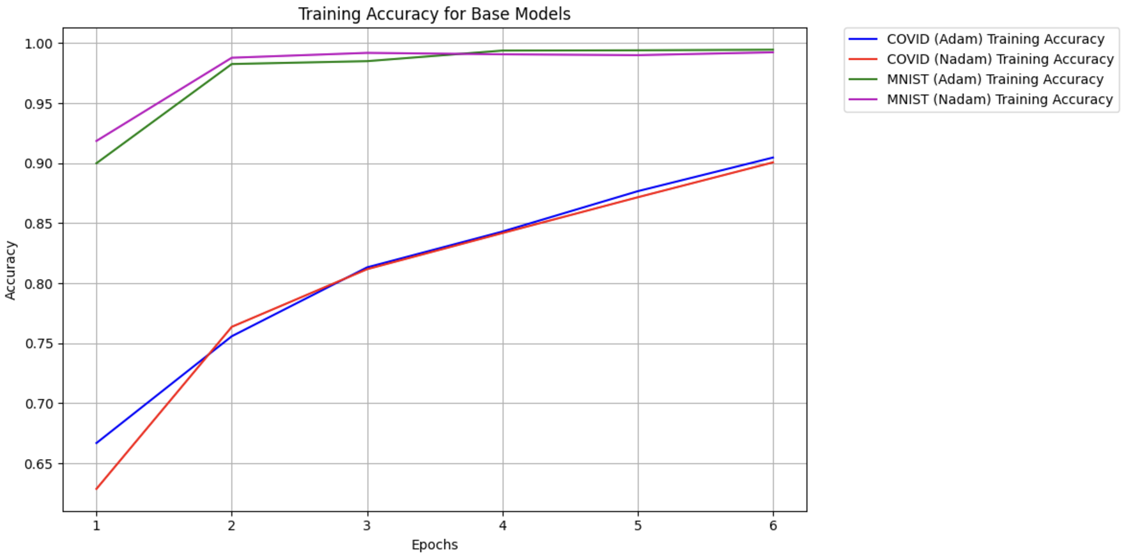
Approach 2 (Layer Slayer)
Simple Model
2 convolutional layers
1 dense layer
1 dropout layer
 | Covid Radiology Dataset | Medical MNIST Dataset
Test Accuracy | Adam: 92.76% Nadam: 91.51 | Adam: 98.73% Nadam: 99.86%

Slide 11
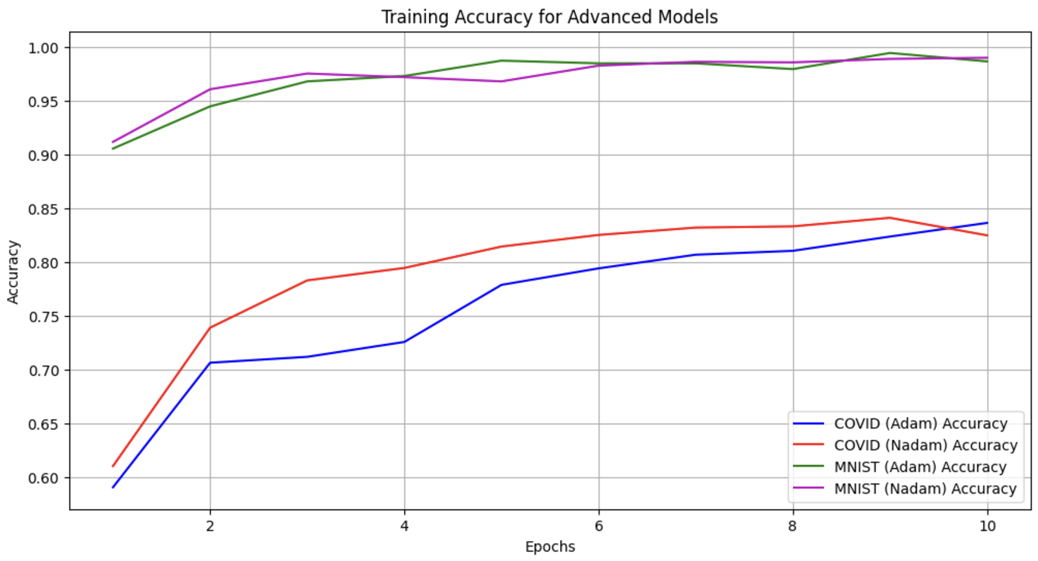
Approach 2 (Layer Slayer)
Bigger Model
3 convolutional layers
3 dense layer
3 dropout layers
Used L2 regularisation
 | Covid Radiology Dataset | Medical MNIST Dataset
Test Accuracy | Adam: 57.40% Nadam: 78.76% | Adam: 98.07% Nadam: 98.29%

Slide 12
Approach 2 (Layer Slayer)
Simple Model | Covid Radiology Dataset | Medical MNIST Dataset
Test Accuracy | Adam: 92.76% Nadam: 91.51 | Adam: 98.73% Nadam: 99.86%
Why the Simple Model Performed Better?
Fewer parameters reduces over fitting
Focuses on extracting the most relevant
Smaller architecture converges more quickly
effectively learns the dominant patterns
Captures key features like edges and texture patterns effectively.
Bigger Model | Covid Radiology Dataset | Medical MNIST Dataset
Test Accuracy | Adam: 57.40% Nadam: 78.76% | Adam: 98.07% Nadam: 98.29%
Notes:
CNN is a great way to extract latent features form images however if a particular layer isn't able to extract meaningful patterns, we keep losing data from that point and get incorrect results and bad accuracy.
To better this, we use Resnet
CNN is a great way to extract latent features out of images, with each passing layer we try to infer more complex features by using the last layer output. But if the last layer isn't able to extract meaningful patterns, we keep losing data layer by layer and get incorrect results. We need a way to infer the latent features out of the image with each layer but also keep the original image to compare and draw better results.

Slide 13
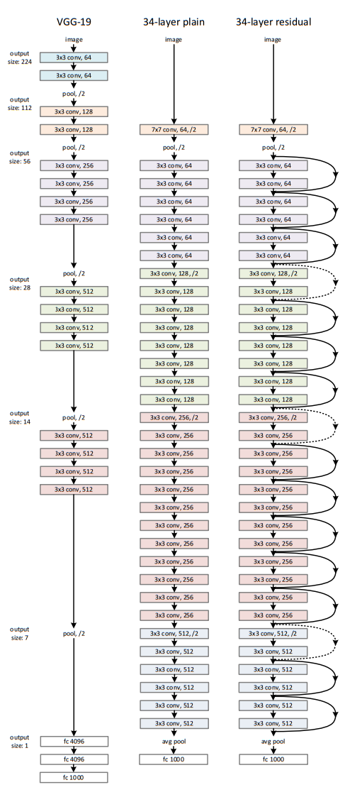
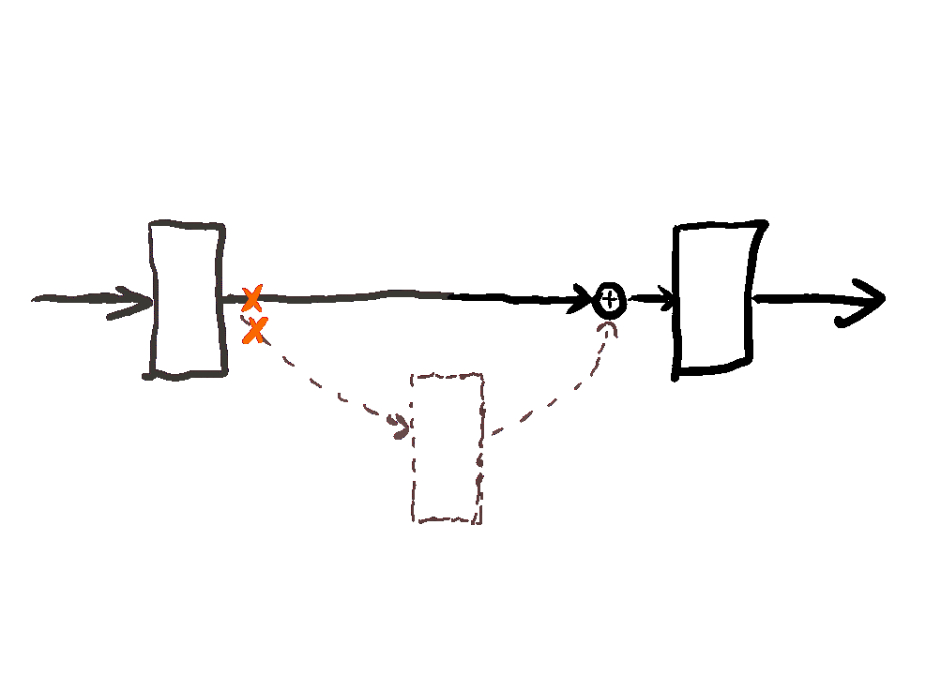
Approach 3 (Shortcut Master)
Deep networks by using residual connections / skip connections.
Solves deep network problems -
vanishing gradients
degradation.
Learn the “adjustments” (residuals) as needed.
Skip connections -> residual block -> stack blocks together -> forms resnet.
ResNet
Notes:
Deep learning faces two key challenges as networks get deeper: vanishing gradients and the degradation problem. ResNet solves this by introducing residual connections. It bypass the underperforming layers and so we get better performance.

Slide 14
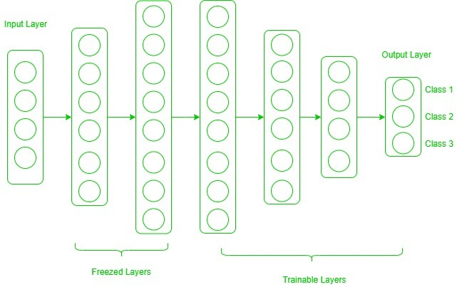
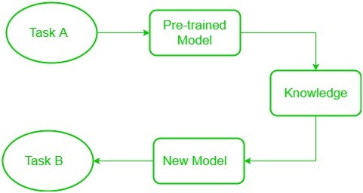
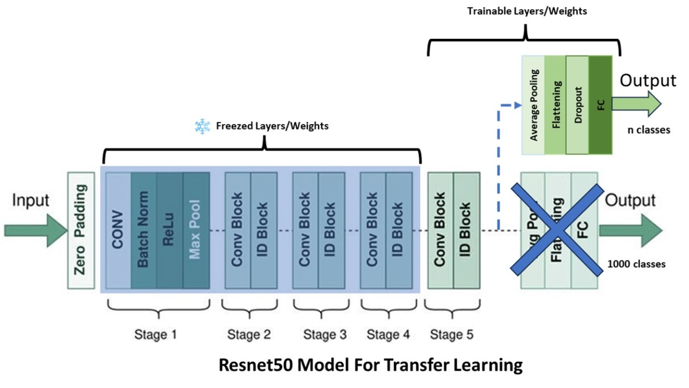
Approach 3 (Shortcut Master)
Transfer knowledge
Pre-trained model is repurposed for foundation of second task.
Steps -
Choose base model
Transfer final layer
Freeze some layers
Fine-tune layer
Save training time, requires less data, better performance.
Transfer Learning
Notes:
Instead of training a model from scratch, Transfer learning technique reuses a pre-trained model by adding and fine-tuning layers, applying prior knowledge to new tasks.

Slide 15
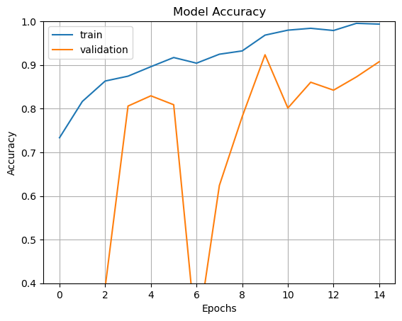
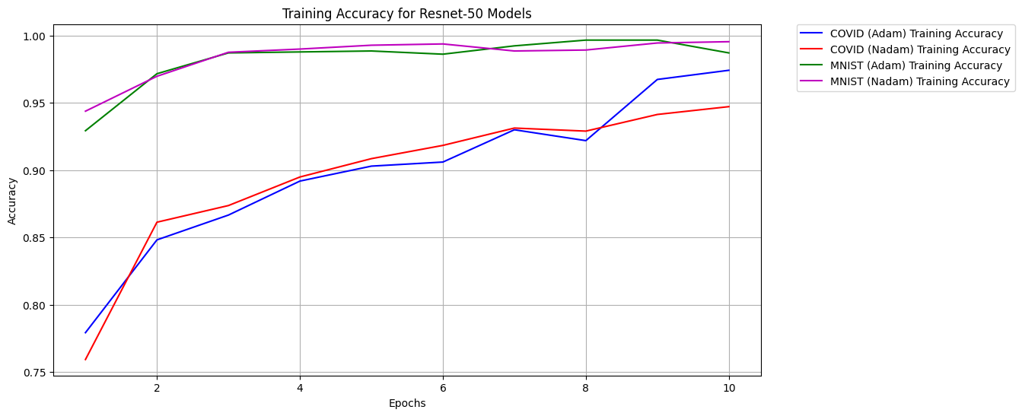
Approach 3 (Shortcut Master)
Fig - Different overfitting model
Base-Model: ResNet50
Pre-trained on ImageNet.
Custom-Layer - GlobalAveragePooling2D, Dense Layer (128 neurons), Dropout, L2, Dense Layer (Softmax).
Freeze base ResNet-50 layers initially.
Fine-tune all layers after training custom layers.
Transfer Learning with ResNet-50
Test Accuracy | Adam | Nadam
COVID | 97.42% | 95.93%
MNIST | 99.96% | 98.08%
Notes:
The base model is ResNet-50, pre-trained on ImageNet. Custom layers were added at the end, and various parameters were tested to optimize the model. The top-right model shows overfitting, which was addressed using regularization and dropout, resulting in the improved model shown at the bottom.
ResNet-50 layers are frozen to retain pre-trained knowledge and then later fine-tuned. As you can see the results are nearly perfect across all the datasets.

Slide 16
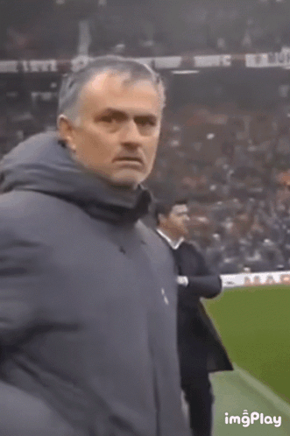

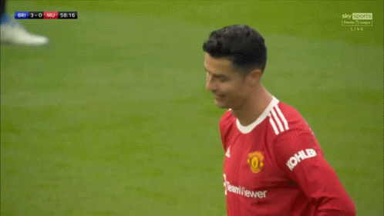
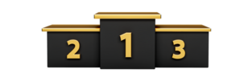
Outcome
Easy tasks – Medical MNIST
Simpler latent features
Small images
All approaches — Amazing
Harder tasks - COVID 19 Radiography
Hidden, complex latent features
Larger images
SVM, kNN < CNN < ResNet
Subtle improvements in complex methods
Huge improvements in performance
Better feature extraction
ResNet-50
Boosted SVM 👎
CNN
Notes:
In our outcome, all 3 approaches were very good for MNIST as it had simple features
For Covid dataset, it was harder to extract the features from lung and hence Resnet is the best, followed by CNN and then SVM/KNN (which sucks)
Overall, it's not just about how well feature extraction is, but how good the inference is, where Neural Networks like ResNet and CNN do much better.

Slide 17
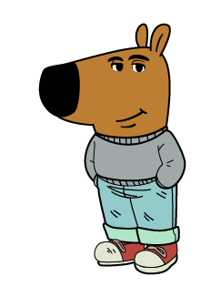
Thank you
Any questions?
Don’t worry, our models are standing by to analyze them. Just make sure they’re within the input dimensions
References
Datasets
https://www.kaggle.com/datasets/tawsifurrahman/covid19-radiography-database
https://www.kaggle.com/datasets/andrewmvd/medical-mnist ResNet - https://arxiv.org/abs/1512.03385

